Slide 1

Should the main Survey / Test functionality have a single or multiple class implementation.
One class combining both Survey and Test functionality
One class for Survey functionality and another class for Test functionality
CS 350 – Software Design – Drexel University

Slide 2

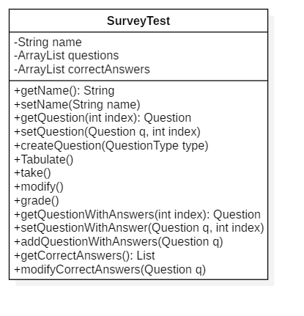
Is this what we learned in class? This solution is fraught with problems. What happens if just a survey is desired? Shall we even talk about the coupling???
This answer earned a Picard single face palm!
Return to previous decision
CS 350 – Software Design – Drexel University

Slide 3

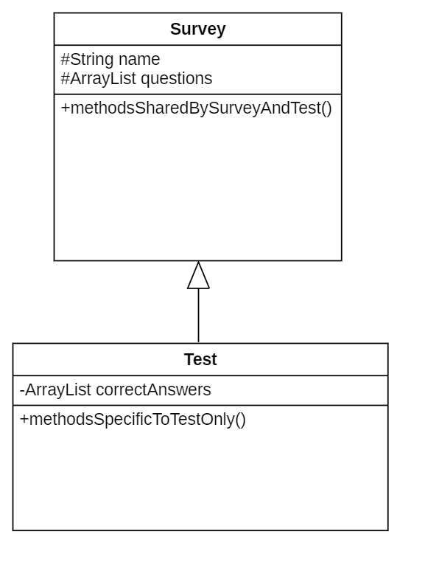
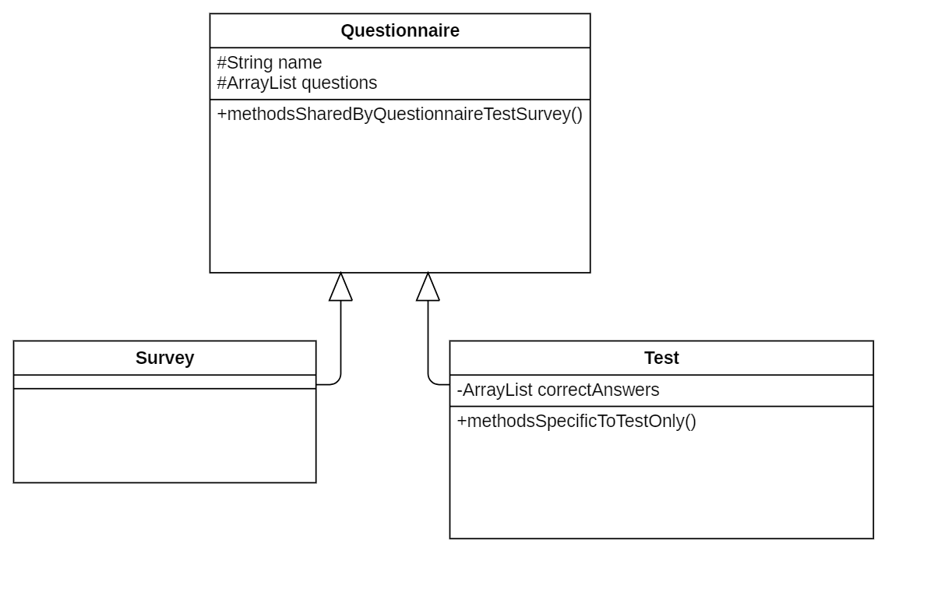
Recognizing that survey and test should be in separate classes is a great start.
However, there is more than one way to implement it.
Click on the design that is preferable
CS 350 – Software Design – Drexel University

Slide 4
This is the superior design.
Having Survey as the base class with Test derived from it allows the Survey class to define what is in common to surveys and tests while separating out the functionality unique to test.
CS 350 – Software Design – Drexel University

Slide 5
Students often create this architecture as a proposed design.
There’s nothing inherently wrong about it, but it’s not right either.
The questionnaire class is basically the Survey class with a different name.
To be correct, there would need to be additional functionality in Survey that is not in the Questionnaire class. This answer earns the coveted Picard double face palm
Return to previous decision
CS 350 – Software Design – Drexel University

